Slide 1
DFA-based roman numeral validator
By Ahmad Naaem Saad Roll no : 23SP-006-CS Theory of Automata​​ (CSC-205)

Slide 2


Project Overview & Motivation
Objective
Validate Roman Numeral (1-50) through DFA.
Convert valid numerals into decimal numbers.
Motivation
To show practical use of DFA.
To use python and its libraries to show working of DFA.

Slide 3

Theoretical Background
Deterministic Finite Automata
Why Dfa?
Limited and Finite number of states.
Each state must have same number of output transition as symbols being used.
Utilization of dead states.
Multiple accepted states.
Best for combinations with a fixed set of rules

Slide 4

Why Python?
Simple syntax for implementing DFA logic.
Strong libraries for graph visualization (NetworkX, Matplotlib).
Easy GUI creation with Tkinter.

Slide 5

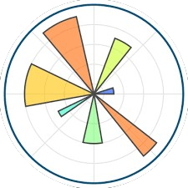

Implementation
Python Libraries
Tkinter
Provides a simple way to create the interactive GUI for user input and output display.
Matplotlib
Renders the DFA graph visually, including state positions and highlighted transitions.
NetworkX
Used to build and manage the DFA as a graph structure with nodes and labeled edges.
​

Slide 6
Design
Class
Functions
RomanDFAApp
The main class that builds and controls the GUI, handles user input, processes DFA logic, and visualizes state transitions.
__init__(self): Sets up the GUI window, input field, buttons, output label, and initializes the DFA graph.
on_close(self): Safely closes the application when the window is closed.
roman_to_decimal(self, s): Converts a Roman numeral string to its equivalent decimal value using right-to-left processing.
build_dfa_graph(self): Constructs the DFA as a directed graph with labeled edges using NetworkX.
draw_dfa(self, highlight_path=None): Visualizes the DFA with Matplotlib and optionally highlights the path taken by a user’s input.
validate(self): Validates the user-entered Roman numeral by simulating transitions through the DFA and updates the output and graph.

Slide 7
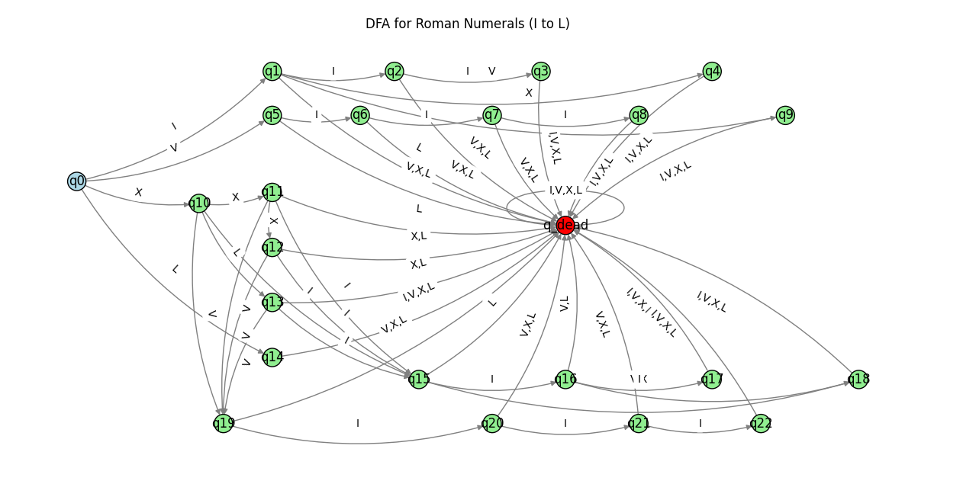
DFA Used For Validation

Slide 8
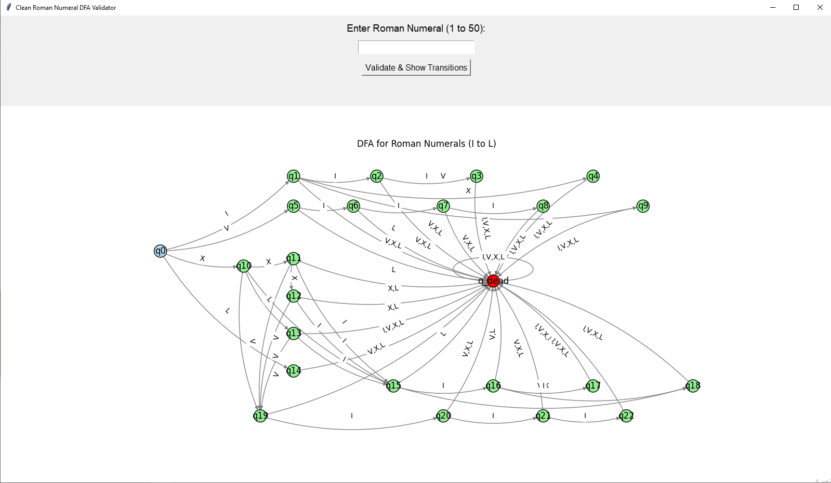
Program UI

Slide 9
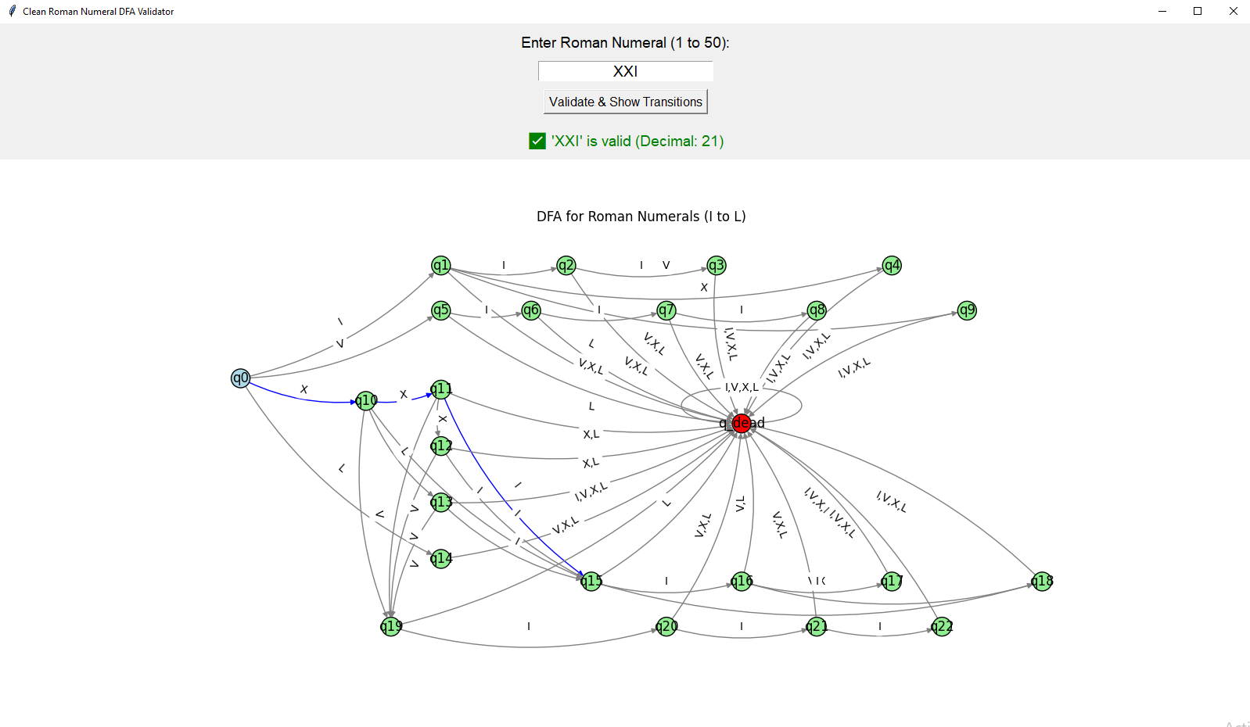
Validation For valid numeral : xxi(21)

Slide 10
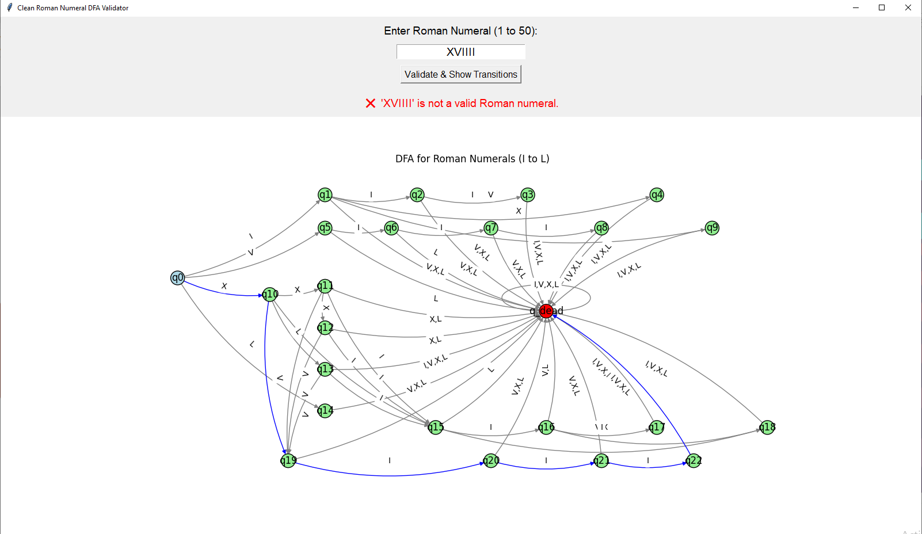
Validation of non-valid numeral: xVIiii

Slide 11
Conclusion
This project demonstrates how DFA can effectively validate Roman numerals, combining theoretical concepts with practical implementation using Python, graphical visualization, and an interactive user interface.

Slide 12
Thank you

